Slide 1
NAPL Seeps Conceptual Model

Slide 2


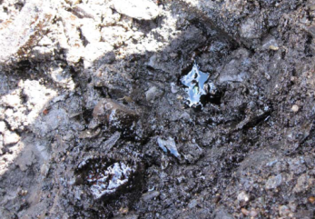

LNAPL Seepage

Slide 3
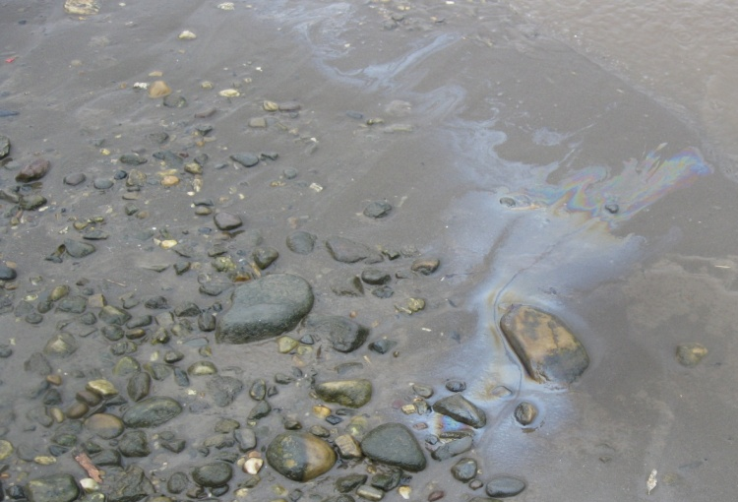
LNAPL Drainage at Low Water
High Water
Low Water

Slide 4
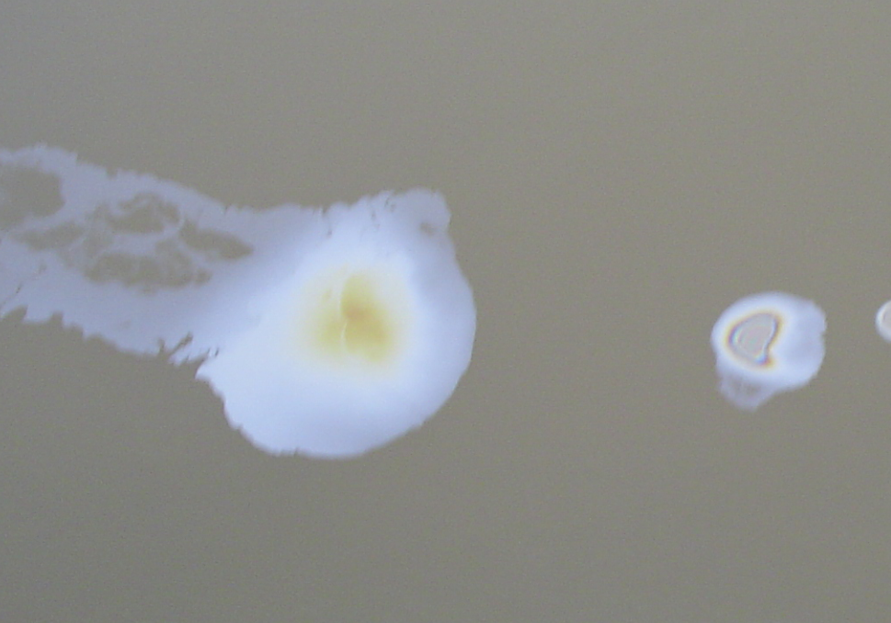
Ebullition

Slide 5
LNAPL Wicking

Slide 6
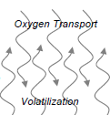
NSZD and NAPL Seepage
Oxygen Transport
Volatilization
Dissolution and Biodegradation
Electron Acceptor Flux
Electron Acceptor Depletion

